Slide 1
LMS Revenue Dynamics
Treasury and Trade Solutions | Liquidity Management Services
December 2016
Strictly Private and Confidential

Slide 2
Agenda
NA LMS terminology
Liquidity premium
Hedge
Operating vs. excess
Client pricing and total NRFF
Return on Assets
2015 client rate sensitivity
2015 rate outlook
Appendix

Slide 3
Summary of Terminology
Key components of NA LMS revenue.
Pool |  | Currently O/N Libor is the default transfer pricing (TPR) Cost for the bank to borrow overnight funds from other banks in the market
Base NRFF |  | Base NRFF is found by calculating the value of the pool (Balances x Pool Rate) then subtracting the total cost of funds (Balances x Cost of Funds)
Liquidity Premium |  | Value assigned to bank funding sources by Treasury, adjusted by an LP factor LP factor is closely tied on LCR value of deposit and amount of operating activity Calculated at an account level by Treasury
Hedge |  | Due to balance stability or a longer expected duration of a certain balance, the regular TPR is swapped for a fixed interest rate (interest rate swaps) Tenor of interest rate swap dependent on portfolio expected stability and duration Treasury tracks balances per portfolio at an account level
Hedge Caterpillar |  | Rolling hedge strategy to constantly refine hedges based on the market rate environment
High Concentration Threshold |  | Level at which if a client pulled their balances there would be a risk of having to break hedges
Operating Deposits |  | Balance level deemed necessary to complete day to day operational services
Excess Deposits |  | Balance levels above the clients operating (payments) activity
Fees |  | Fees have two components for NA LMS as it generates revenue primarily from DDAs, but also with the fee offset function from ECR that is returned as NRFF to the products for which the fees are offset for
1

Slide 4
Liquidity Premium
Liquidity Premium is a Treasury allocation assigned to deposits, based on the operating nature and run off of the deposits, to incent desirable sources of bank funding.
Classification | Types of deposits | LCR Value | Liquidity Premium allocated
Corp / PS Operating | ECR IBDDA / Sweeps | 75% on non-excess portion; Excess portion receives non-operating LCR value | Non-excess portion receives 0.25%; Excess portion receives non-operating LP
Corp / PS Non-operating | MMDAs Excess deposits | 60% | 0.20%
FI Operating | ECR IBDDA / Sweeps | 75% on non-excess portion; Excess portion receives non-operating LCR value | Non-excess portion receives 0.26%; Excess portion receives non-operating LP
FI Non-operating | MMDAs Reserve Bank Accounts Excess deposits | 0% | 0.07%¹
Brokered Sweeps | All | 75% retail / 60% wholesale | 0.25% / 0.20%
Collateralized Deposits | PS related interest-bearing deposits that are collateralized by munis / treasuries / FHLB LC’s | Treasuries - 100% (Subtracted from HQLA) Other – 75% / 60% | 0.00%
31+ Day MMTD | All tenors | 100% | 0.33%
FI TDs | All | 0% on TDs <30 days 100% on TDs >30 days | 0% on TDs<30 days 0.15% on TDs <30 days and >1 year 0.33% on TDs >1 year
Corp/PS TDs | All | 100% | 0.33% on TDs >1 year 0.15% on TDs <1 year
1. Treasury assigned a minimum of 0.07% LP to deposits
2

Slide 5
Hedge
Due to stability of balances by portfolio it is necessary to hedge balances for fluctuating market rates.
 | ECR | IB DDA | Sweep | Broker Sweep | RBA | MMTD
Low Concentration | 5 Year | 3 Year | 3 Year | 3 Year¹ | 3 Month | 3 Month/ Existing
High Concentration | 3 Month | 3 Month | 3 Month
Different hedge tenors are determined by balance stability and the expected duration of a deposit
Deposits that have longer expected durations and greater amount of operating activity can be hedged at a longer tenor to reduce the firm’s exposure to shifts in market rates
In order to properly mitigate market rate fluctuation risk, hedge caterpillars were created
Example - 3 year caterpillar
Balance are divided into 36 monthly tranches that are all invested at different tenors (1/36 at 1 month, 1/36 at 2 months, etc.)
As tranches roll off at the end of the hedged tenor and booked at the full 3 swap year rate
As hedges roll monthly, hedges will continuously adjust to market conditions limiting Citi exposure
The hedgable balances within each portfolio is dependent on regression analysis run by Treasury
If the current balance is above the regression line, then the portfolio will not be fully hedged. (see slide 5)
Only $31.6 Bn out of the total $35.1Bn of the Corporate ECR portfolio could be hedged for January (using December’s balance level) as the balance was above the regression total
In 2015, there potential for ECR balances to shift to Sweep/IB DDA as clients will be required to hold less in balances to offset existing fees, should rates start to rise.
Example: $1BN shifting from ECR to IB would result in a revenue loss of $2.9MM
1. Broker Sweeps also hedged at 3 month Libor and overnight depending on agreed pricing and tenor
3

Slide 6
Hedge: NA Portfolio descriptions
Portfolio | Description | Concentration Threshold (portion hedged as low concentration balance, at an entity level) | Hedge tenor
NA ECR | ECR / NIB balances on the 920/930 (Corp) Platform | $1.1Bn | Low con portion: 100% 5 year High con portion: 100% 3 month
Corp & Other Sweeps | Compressed sweep portfolio where indexed-rate portfolios are compressed at 1bps on the Corp Platform | $1.5Bn | Low con portion: 80% 2 year OIS High con portion: 100% 3 month
NA Corp ECR Intercompany | Intercompany ECR/NIB balances on the Corp Platform | N/A | 90% 5 year
Cash MMDA/CDS North America | Managed-rate Interest bearing (IB DDA / Sweeps) on the Corp Platform | $1.3Bn Also, rate sensitive clients and all reserve bank accounts are hedged as high conc. | Low con portion: 100% 3 year High con portion: 100% 3 month
3 YR / 3 Month Libor Broker Sweep | Managed-rate brokered sweeps hedged at 3 years 3 Month hedges for indexed balances | N/A | 3 Year for longer term managed 3 Month Libor indexed balances
4

Slide 7
Deposit Balance Concentration Threshold Calculation
Threshold
Regression Slope
Investment Maturity in One Month
=
+
Slope of 36 month regression line
Or zero if 12 month simple average < 12 month core average
12 month simple average = average of previous 12 months’ balances
12 month core average = average of previous 12 months’ core (last point on regression)
Determined by hedge eligible balances divided by months in GOT tenor
Hedge eligible balance is minimum of client balances and core balances
Example 1: 100% 3 Year Caterpillar
Threshold
=
Regression Slope
+
Investment Maturity in One Month
40
Slope = 10
12 month simple average = 1,100
12 month core average = 1,000
Hedge eligible balances = 1,080
Tenor = 36 months
One month maturity = 1,080/36 = 30
Use slope
Example 2: 100% 5 Year Caterpillar
Threshold
=
Regression Slope
+
Investment Maturity in One Month
20
Slope = 10
12 month simple average = 1,000
12 month core average = 1,100
Hedge eligible balances = 1,200
Tenor = 60 months
One month maturity = 1,200/60 = 20
Use 0
5

Slide 8
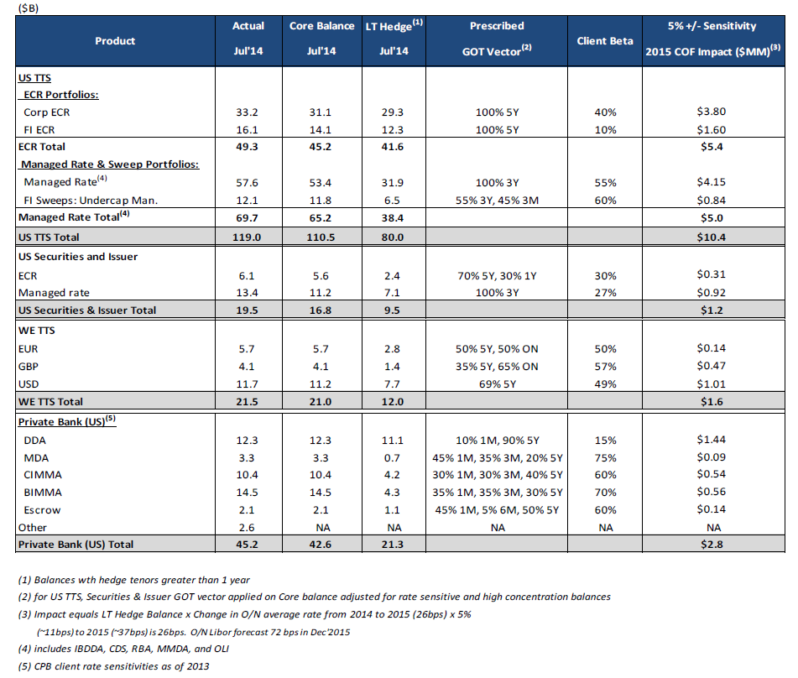
Deposit Balance Concentrations: All Portfolios
6

Slide 9
US TTS USD Transfer Pricing Investments
5 Year +$0.9B driven by FI ECR +$0.7B & Corp ECR +$0.7B on regression seasoning of balances, partially offset by decline in FI Overcap Sweeps from Guangdong Development Bank -$0.6B 3 Year +$1.1B on (1) FI Undercap Managed banking clients from International regions +$0.5B, (2) Managed Rate +$0.3B across multiple clients and (3) Brokered sweeps NFS +$0.2B 3 Month Managed Rate HC & Rate Sensitive -$2.8B driven by Reserve Bank Account -$2.0B (BCI -$1.1B, MS -$0.6B & Ameriprise -$0.3B), Yahoo MMTD -$1.3B, Central Bank of Turkmenistan -$0.6B, and Twenty First Century Fox -$0.5B. Offsetting increases were Uber +$1.3B and MMTD +$0.3B
Portfolio previously called MMDA/CDS. Includes IBDDA (~$29B), CDS (~$18B), RBA (~$1B), MMDA (~$2B) and OLI (~$1B). Managed Rate HC & Rate Sen includes 3M LIBOR Broker Sweeps
For portfolios with high concentration framework, Hedgeable Balance is minimum of Regression Core and GAAP balances. For portfolios without high concentration framework, Hedgeable Balance is Regression Balance * 1.11 capped to GAAP balances if GAAP balances are higher than regression balance. If GAAP balances are less than Regression Core, Hedgeable Balance is Regression Core if GAAP balance is > than 90% of Regression Core subject to maximum difference of $750MM between Regression Core and GAAP balance.
Compression hedges which are executed using term OIS Swaps rather than LIBOR/Swap. Spread between those curves is around 15bps with OIS having lower yields
7

Slide 10
How to Think About Operational Deposits
Deposits are deemed to be operational only if they are necessary to complete operational services. If a client can redirect funds without reducing operational services, that portion of the deposits must be re-classified as non-operational.
Operational Services:
Remittances
Reconciliation and confirmation of payment orders
Payroll administration
Transfer of capital distributions
Collection and aggregation of funds
Cash Management
Clearing
Daylight overdraft
Intra-day and final settlement positions
Customer subscriptions and redemptions
Custody
Settlement of securities transactions
Cashflow related to safekeeping of assets
Escrow, funds transfer, stock transfer, and agency services, including payment and settlement services, payment of fees, taxes, and other expenses
Corporates LCR Treatment
Non-operating (excess) % of Balances
Operating % of Balances
+
+
+
=
% LCR Value of a Deposit
75%
60%
8

Slide 11
Pricing and NRFF
Pricing aligned with total portfolio spreads and LCR targets.
 | ECR | Operating IB | Corp/PS Non-Op IB | FI/ NBFI Non-Op IB | RBA | Minimum Maturity Time Deposit¹
Standard Client Rates | 0.45% | 0.38% | 0.30% | 0.10% | Approval Required | 0.47% - 0.68%
Pool | 0.36% | 0.36% | 0.36% | 0.36% | 0.36% | 0.36%
Hedge | 1.25% | 0.94% | 0.94% | 0.94% | 0.62% | 0.62%
LP | 0.26% | 0.26% | 0.21% | 0.07% | 0.07% | 0.35%
Total | 1.87% | 1.56% | 1.51% | 1.37% | 1.05% | 1.33%
Net Spread | 1.42% | 1.18% | 1.21% | 1.27% | Variable | .65%-.86%
Standard rates are based on desire to raise LCR and revenue accretive deposits
Heavy reliance on Sales partners to adjust standard pricing based on market intelligence
Broker Sweep programs are long-term contractual agreements, therefore the portfolio is a blend of long and short-term hedges to limit market exposure
MMTD client rate is based on tenor (31 day – 0.47%, 45 day – 0.50%, 60 day – 0.58%, 90 day – 0.68%), All new balances are hedged at 3 Month LIBOR, while conversions are hedged at the previous deposit types tenor (IBDDA – 3 year, ECR – 5 year).
Based on average current pricing. Product approval required on all deals.
9

Slide 12
Return on Assets
Measure of how efficiently assets are used to generate revenue.
Return on Assets (ROA):
Citigroup current ROA is 94bps with a continued commitment of 90-100bps
Asset allocation is the greater of the hedge allocation, runoff or collateral held
Hedges – 90% of the hedges with a tenor greater than 1 year
Runoff – determined by the type of deposit and excess amount
Collateral – typically only for public sector entities (treasuries only)
Net Income
Total Assets
Example
- Apple has a $100MM Sweep priced on a managed rate with 20% excess
Hedge: Amount of balance in 3 year hedge x 90% x $100MM = $90MM
Runoff¹: 80% Operating x 25% + 20% Non-Operating x 40% = $28MM
Treasury and Purchased Muni Collateral: 100% of collateral held = $0
1. Includes Muni, when already held by Citi, and FHLB LC collateral
10

Slide 13
2015 Client Rate Sensitivity
If rates rise in line with CCAR forecasts, we expect our more rate sensitive clients to demand nearly proportionate increases in their deposit rates.
NA Liquidity Management View
ECR Client Breakdown | % of Balances | % Change in Rate | Methodology | Rates
Category 1 | 18% | 85% | 3 Month Moving Average | 3 Month LIBOR
Category 2 | 30% | 60% | 3 Month Moving Average | 3 Month LIBOR
Category 3 | 30% | 23% | 3 Month Moving Average | 3 Month LIBOR
Category 4 | 20% | 10% | 3 Month Moving Average | 3 Month LIBOR
Category 5 | 2% | 100% | 3 Month Moving Average | 3 Month T-Bill
IBDDA Client Breakdown | % of Balances | % Change in Rate | Methodology | Rates
Highest | 43% | 85% | 3 Month Moving Average | 3 Month LIBOR
High | 34% | 75% | 3 Month Moving Average | 3 Month LIBOR
Moderate | 17% | 55% | 3 Month Moving Average | ON LIBOR
Lower | 6% | 45% | 3 Month Moving Average | ON LIBOR
NA Treasury View
 | % Change in Rate | Methodology | Rates
ECR | 44% | 3 Month Moving Average | 3 Month LIBOR
IBDDA | 60% | 3 Month Moving Average | 3 Month LIBOR
11

Slide 14
Hedge Caterpillars
NA LMS utilizes hedge caterpillars to mitigate risk from interest rate fluctuations.
5 Year Caterpillar vs. Steepening Yield Curve
1.25%
0.42%
5 Year Caterpillar vs. Steepening Yield Curve
0.14%
0.42%
12

Slide 15
Appendix
13

Slide 16
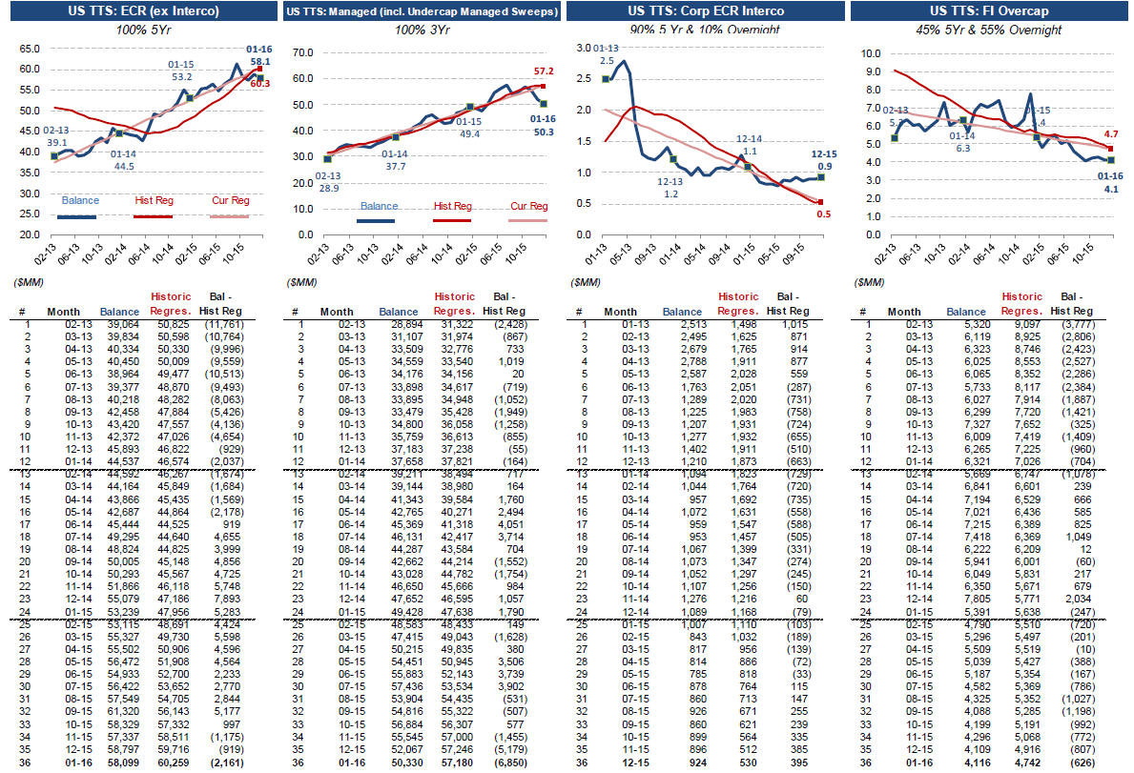
NA Key Regressions: US TTS
14

Slide 17
LMS NRFF Revenue - Data Process
 | Base NRFF | Hedge | Liquidity Premium
Sources | For DDAs: Citichecking calculates the interest expense; SMART calculated the Pool For Sweeps: Opics calculates interest expense and pool | Allocation from Corp Treasury | Allocation from Corp Treasury
Data details (Owners: Treasury) | N/A – automated through Oasis | Revenue at Portfolio level from Hedge tickets / Hedge P&L file | Client level details from 4G file
Cross-regional and Client level split (Owners: Finance) | N/A – automated through Oasis | Each portfolio further split up into account level details provided by treasury AMC region / client GFCID mapped in at an account level | AMC region / client GFCID mapped in at an account level
Reporting | Client level reporting: Data fed into CIW -> GAPS Financial reporting: Data fed into SMART -> PEARL
15

